Slide 1
What is a land worth?
Omar Saleh

Slide 2
Problem Statement
Can I get a credible quick estimate?
Similar realestate can go for varied prices
Formal valuations can be expensive
Are some property ads a scam?

Slide 3
Approach
Gather live listing
Cluster based on location and services
Offer a credible interval on price
Estimate availability of services at given location

Slide 4
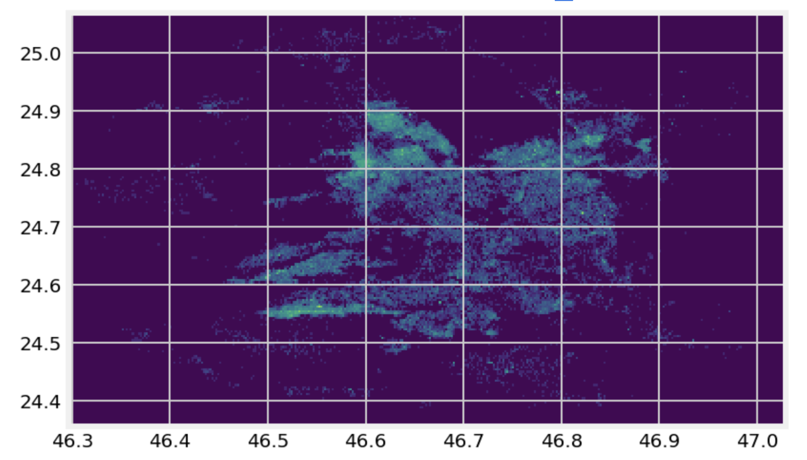
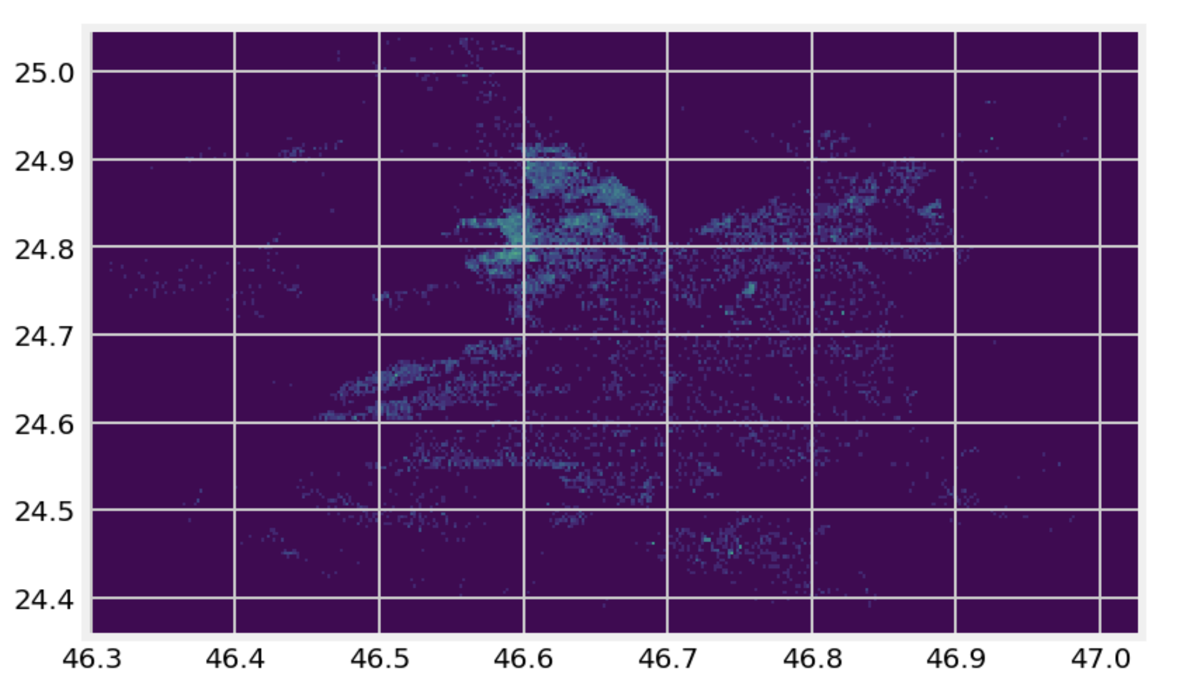
The Landscape
Density depends on location and type
In Riyadh, land is being sold north
All Offerings
Land Listings

Slide 5
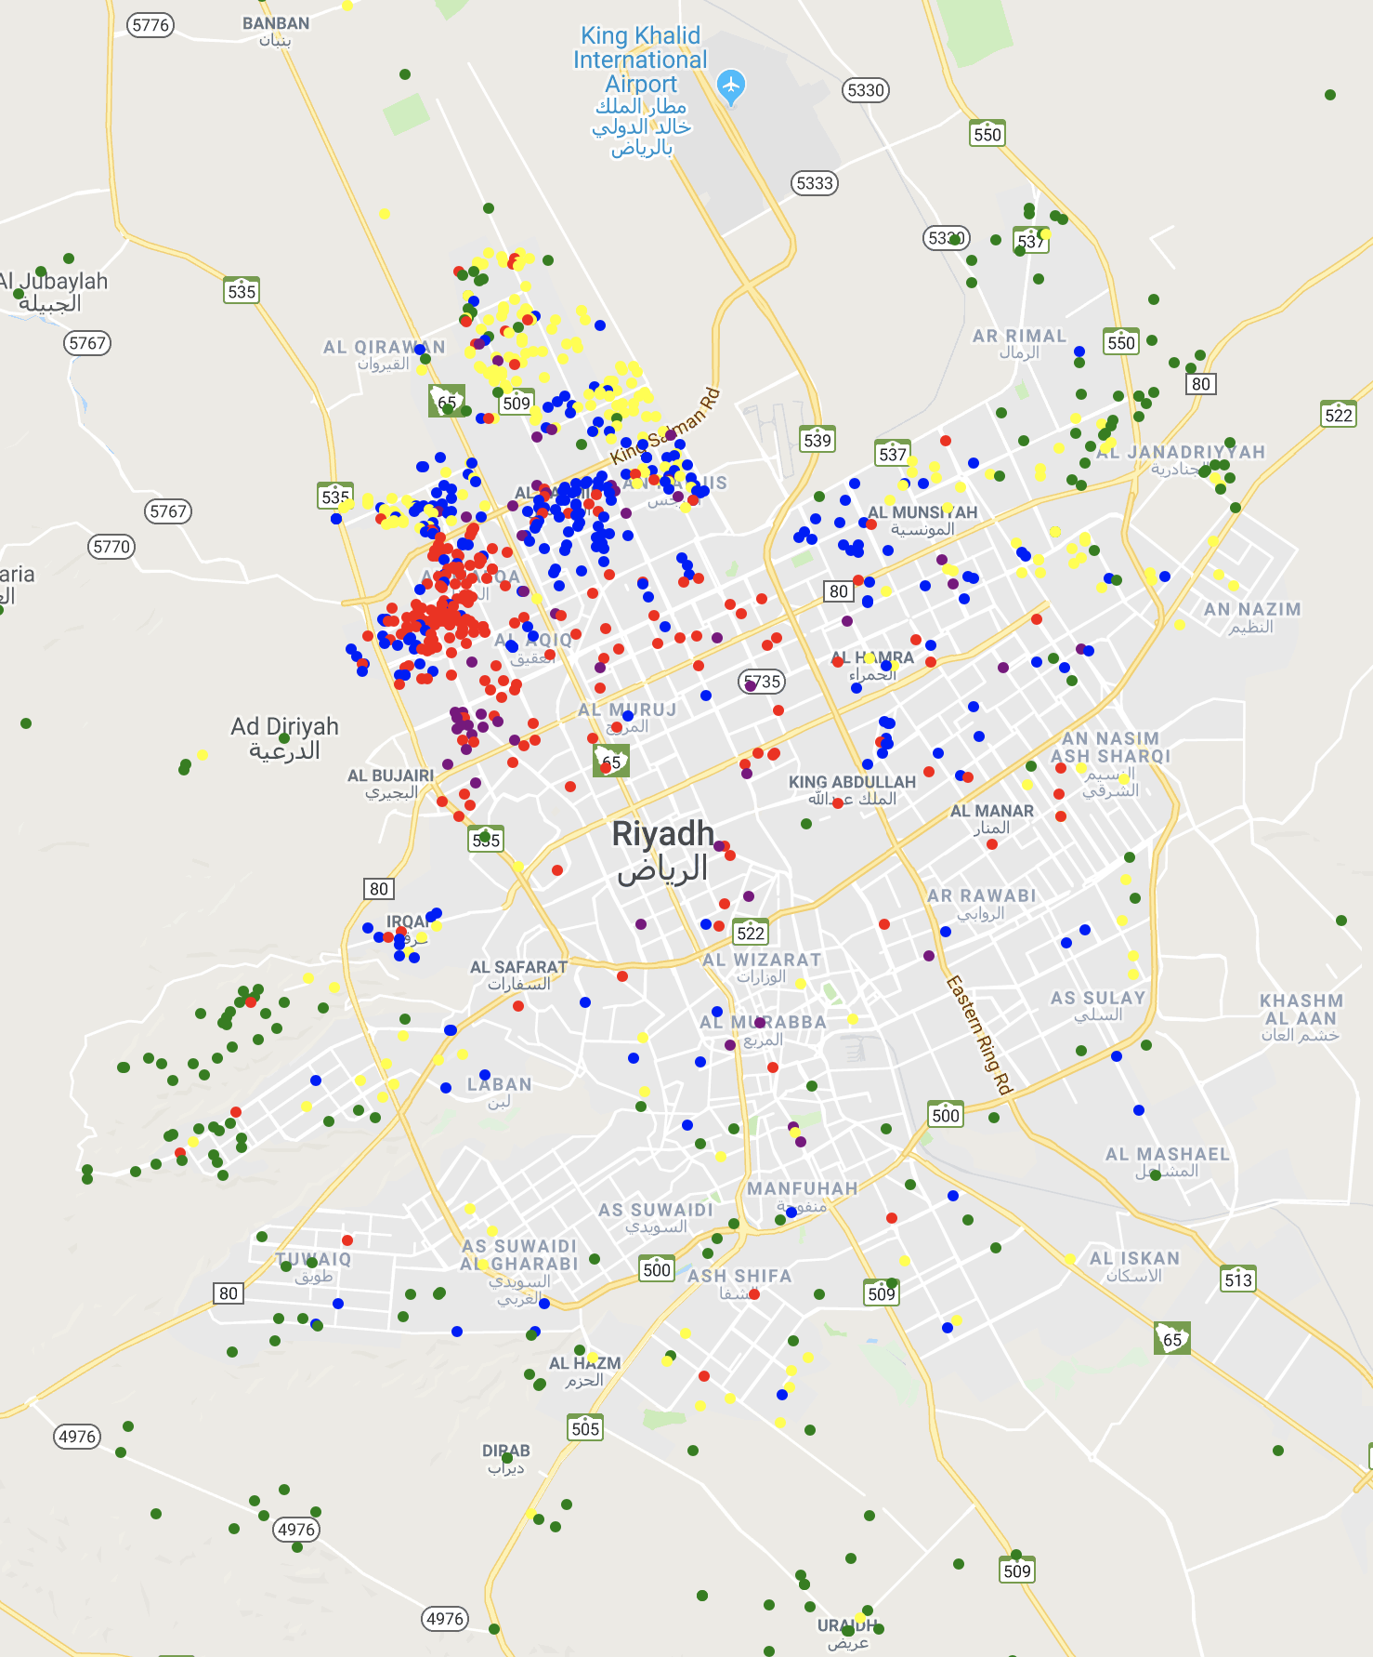
Price Per Meter
Cheap land scattered in low densities outward
Average priced dense towards the north
Above average notably south king Salman Rd.
High prices associated with larger plots of land

Slide 6
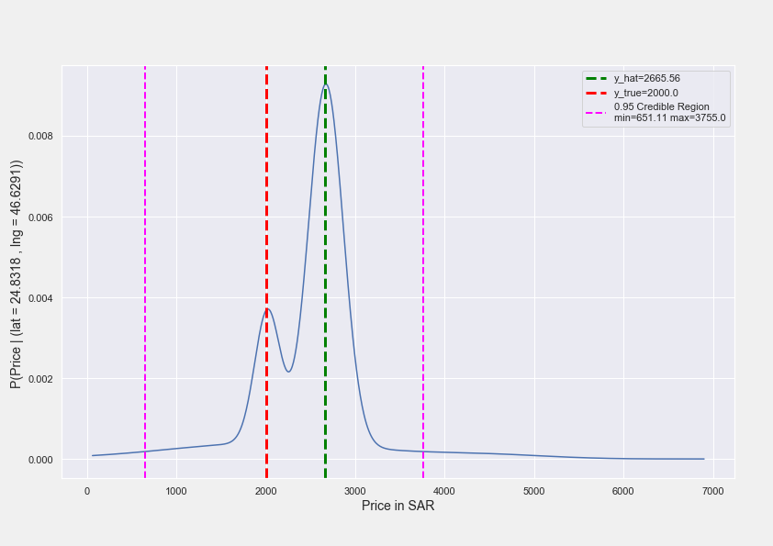
Credible Predictions
Data distribution is captured
Can condition on a location, to derive a credible region for price

Slide 7
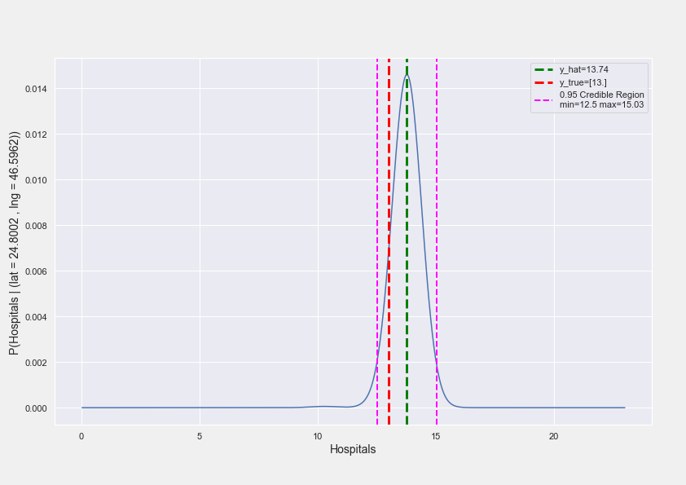
Flexibility
Query by conditioning
How many schools or medical center are nearby?
Being generative, the entire input is modeled
Can run simulations

Slide 8
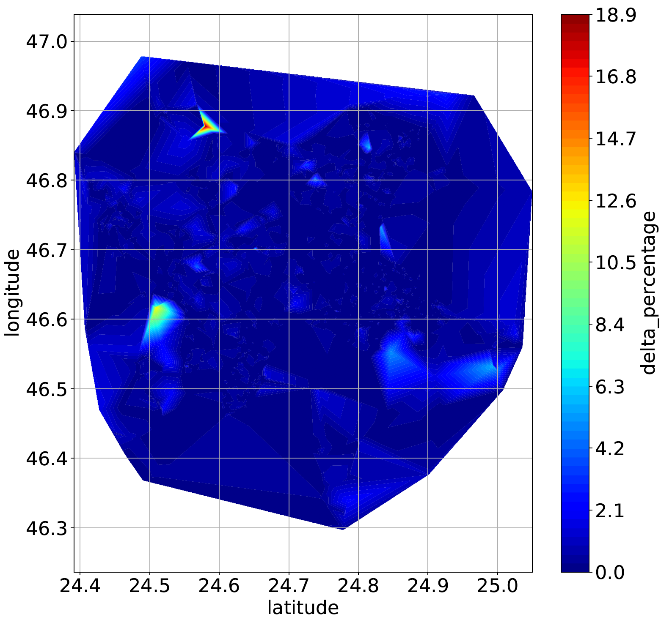
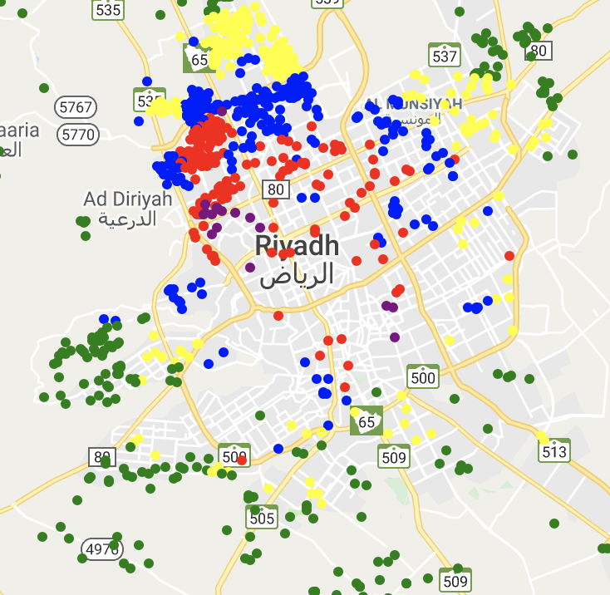
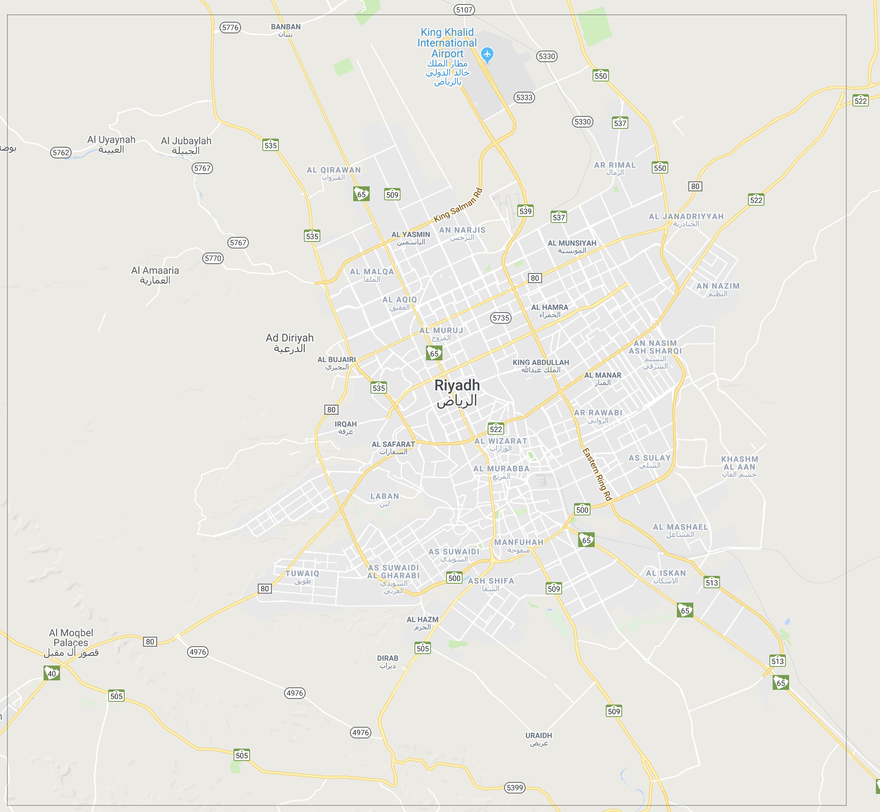
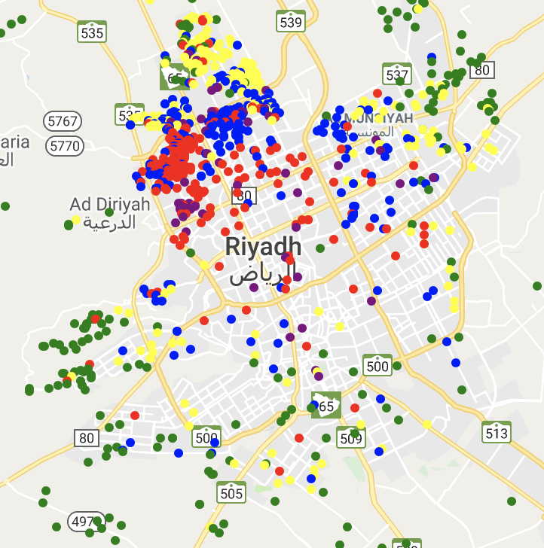


”Ground” Truth?
Conditioning on latitude and longitude:
Avg. price error: 387.61 SAR
R^2 (price): 0.5566
R^2 (schools): 0.9876
Same schools?
$$y$$
$$y$$

Slide 9
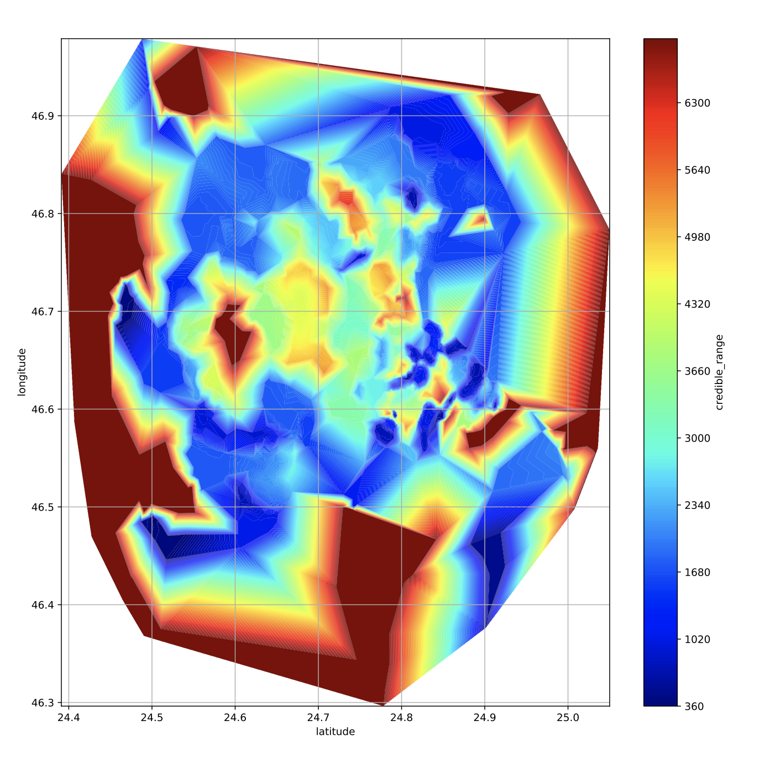
SUMMARY
We are able to predict prices while gauging uncertainty
0.93 of observations fall under credible range

Slide 10
Future Work
Explore time series data, to gauge opportunity
Tighten credible regions / seek domain expertise
Create an engaging user interface experience

